Slide 1
Prediction of Chronic Kidney Disease - A Machine Learning Perspective
Michał Jasiński
Presented By : Asika Islam
ID : 22273013

Slide 2
INTRODUCTION
Chronic Kidney Disease prediction has been discussed in this article.Chronic kidney Disease means your kidneys are damaged and not filtering blood the way it should.Chronic Kidney Disease is one of the most critical illness nowadays and proper diagnosis is required as soon as possible. Machine learning technique has become reliable for medical treatment. With the help of a machine learning classifier algorithms, the doctor can detect the disease on time.

Slide 3
RESEARCH GAP
In this research paper used three different feature selection algorithms for find the algorithm most beneficial to extract the important feature for the prediction of Chronic Kidney Disease. As many datasets have imbalanced class,class balancing is needed for increasing the performance of classifier model. SMOTE was used as a class balancer. According to the highest accuracy of the model was 99.7%, but its a risk calculation of the patient whereas the main aim of the article is to predict Chronic Kidney Diseases.

Slide 4
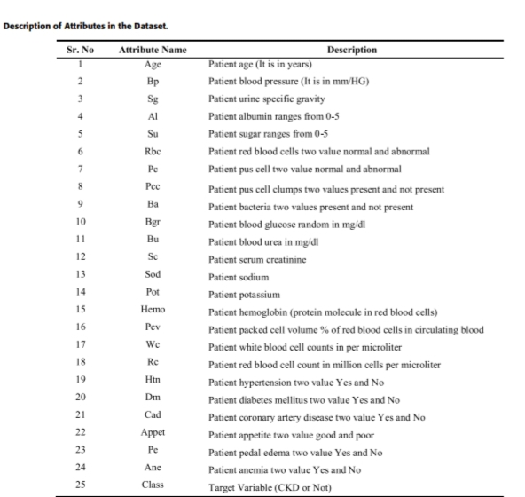
METHODS AND MATERIALS
DATASET
METHODOLOGY
FEATURE SELECTION
CLASSIFICATION ALGORITHMS
SMOTE

Slide 5
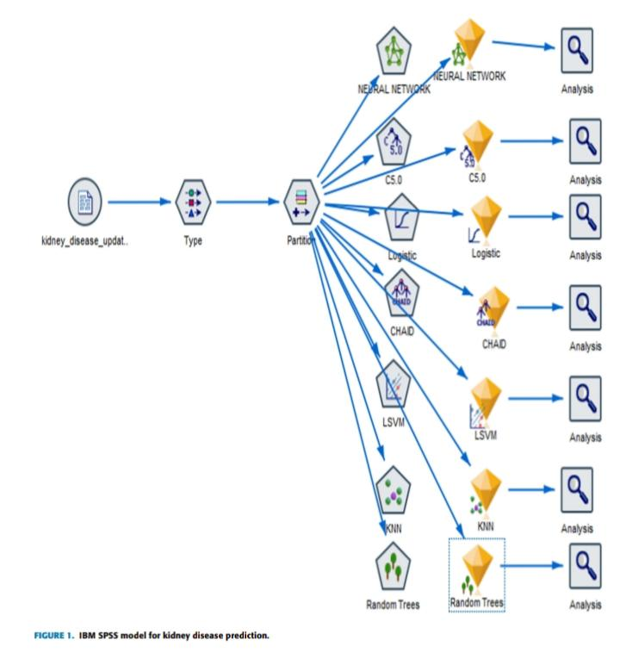
EXPERIMENTAL AND RESULT
RESULT WITHOUT FEATURES SELECTION
RESULT OF CORRELATION-BASED FEATURE SELECTION
RESULT OF WRAPPER FORWARD FEATURE SELECTION AND CLASSIFICATION
RESULT OF LASSO FEATURE SELECTION
RESULT OF SMOTE

Slide 6
DISCUSSION OF MACHINE LEARNING MODELS
All the machine learning models Logistic and KNN classifiers give satisfactory result also shows negligible difference between precision and recall value. Logistic and KNN classifiers is low whereas recall is high. It indicates that these two classifiers give many False positive results due to unbalanced dataset. Logistic and KNN algorithms have not enough capacity to distinguish between positive class and negative class as the related AUC score is very low. Along with AUC, the GINI coefficient is also not satisfactory. Logistic and KNN are not suitable for the prediction of CKD. LSVM model achieved the highest accuracy in majority cases.

Slide 7
PERFORMANCE COMPARISON OF MACHINE LEARNING MODEL AND DEEP NEURAL NETWORK
The machine learning model results was discussed according to it LSVM with penalty L2 performed best in SMOTE with full features and achieved the highest accuracy .The deep neural network achieved the highest accuracy from among all models. In order to compare the performance of two models, McNamara's test was applied. LSVM with SMOTE for all features and a deep neural network was taken and their significant value was noted.After this test the highest accuracy was achieved by machine learning model.

Slide 8
CONCLUSION
The full paper based on predict Chronic Kidney Disease. CKD dataset is the most important features of these paper.For feature selection three different techniques have been applied: correlation based feature selection, Wrapper method and LASSO regression. In this perception, seven classifiers algorithm were applied viz. artificial neural network, C5.0,logistic regression, CHAID, linear support vector machine, K Nearest neighbors and random tree. As per the result of these paper SMOTE gave better results with selected features by LASSO regression as compare to without SMOTE on LASSO regression model. LSVM achieved the highest accuracy in all experiments as compared to other classifiers algorithms.

Slide 9
Thank You

